Slide 1

Spring Boot Security

Slide 2
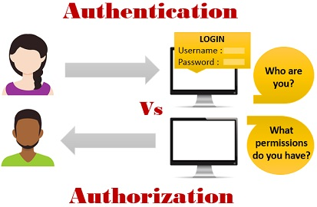
Spring security Overview
Spring Security is separate module which can be added to any module
As a developer no need to think about the security for the application
Spring Security is a framework that focuses on providing both authentication and authorization

Slide 3
Getting Started Spring Security Boot
Add Spring security any common spring boot application by just adding spring security maven dependency
<dependency>
<groupId>org.springframework.boot</groupId>
<artifactId>spring-boot-starter-security</artifactId>
</dependency>
This will include the SecurityAutoConfiguration class – containing the initial/default security configuration.
The default UserDetailsService has a single user. The user name is user, and the password is random and is printed at INFO level
we can also configure properties for our own username and password
spring.security.user.name
spring.security.user.password

Slide 4
Core Components
SecurityContext
As the name implies, this interface is the corner stone of storing all the security related details for your application.
a SecurityContext will enable for each application and stores the details of authenticated user
2. SecurityContextHolder
By default the SecurityContextHolder uses a ThreadLocal to store these details, which means that the security context is always available to methods in the same thread of execution
Object principal = SecurityContextHolder.getContext().getAuthentication().getPrincipal();
if (principal instanceof UserDetails) {
String username = ((UserDetails)principal).getUsername();
}

Slide 5
UserDetails
UserDetails is the adapter between your own user database and SecurityContextHolder.
UserDetailsService
UserDetailsService is a core interface in spring security to load user specific data.
This interface is considered as user DAO and will be implemented by specific DAO implementations.
InmemoryUsersManager
It stores static User information in some thing like Inmemory
It is easy to implement
This is not recommended to use but we can use for practice
DaoAuthiticationProvider
This class uses to retrieve user information which is there in database
It is recommended to use in place of InmemoryUsersManager

Slide 6
Working with InmemoryUserDetailsManager
@EnableWebSecurity
@Configuration
public class WebSecurityConfig extends WebSecurityConfigurerAdapter{
@Override
@Bean
protected UserDetailsService userDetailsService() {
List<UserDetails> users = new ArrayList<>();
users.add(User.withDefaultPasswordEncoder().username("abc").password("xyz").roles("user").build());
return new InMemoryUserDetailsManager(users);
}
}

Slide 7
DaoAuthiticationProvider
1)Add dependency
<dependency>
<groupId>mysql</groupId>
<artifactId>mysql-connector-java</artifactId>
<version>5.1.46</version>
</dependency>
<dependency>
<groupId>org.springframework.boot</groupId>
<artifactId>spring-boot-starter-data-jpa</artifactId>
</dependency>
2. add information in properties file
spring.datasource.username=root
spring.datasource.password=root
spring.datasource.url=jdbc:mysql://localhost:3306/sys
spring.datasource.driver-class-name=com.mysql.jdbc.Driver

